Slide 1
Let There Be Light!
Presented by Team LUMOS
Joe Viveiros | Matt Weingarten | Meriç Bal | Pablo Hernandez | Woojae Yi
February 10, 2017
TEAM LUMOS

Slide 2
Agenda
TEAM LUMOS
About the Team
Tech Stack
Demo
Challenges
Future Steps

Slide 3
About TEAM LUMOS
Introducing the shining stars of Team LUMOS
TEAM LUMOS

Slide 4




Meet Team LUMOS
TEAM LUMOS
“Live in rooms full of light.” - Cornelius Celsus
Woojae Yi
Joe Viveiros
Pablo Hernandez
Meriç Bal
Matt Weingarten
Celery Consultant
Server Scallywag
Flask-Ask me about it
Alexa Whisperer
Algorithm Aficionado
Hardware Guru

Slide 5



Our Story
TEAM LUMOS
Do you live in an apartment with that lacks natural sunlight?
Or perhaps you are simply missing the shining sun?
Using AlexaPi
Bring the sun to you!
We, Team LUMOS, have brought the convenience of voice command to your life with just a fraction of the cost of Amazon’s Echo devices.
Using a RaspberryPi 3 as our “Alexa Hub,” we can use Custom Alexa Skills to talk to our LIFX smart bulbs AND
LIFX bulbs come standard with wi-fi and have their own documentation for using their HTTP API.
Note: These custom Alexa Skills are currently exclusive with the LIFX smart LED bulbs, but future development may include other compatible hardware.

Slide 6
Features
TEAM LUMOS
Automated Mode
Static Modes
Alarm mode
Set your personal light alarm for waking up more naturally
Custom sunrise and sunset times.
Set sunrise to your local sunrise time
Sunrise, sunset, romance, night etc..

Slide 7








Our Tech Stack
TEAM LUMOS
Thank you to all the services used:

Slide 8


Overview
TEAM LUMOS
Celery Master Worker
Alexa API
Amazon
Flask Backend
AlexaPi

Slide 9
AlexaPi Demo
TEAM LUMOS
Automated mode
Automated mode mocks the light outside which means sunrise and sunsets

Slide 10


Functions
TEAM LUMOS
Brightness
Kelvin
100%
6500 K
50%
2500 K
0%
Sunrise
-x^4 + 1
Sunset
Sunrise
-0.69x^2 + 1* 6500
Sunset

Slide 11
Our Roadmap
TEAM LUMOS
From February 2 - February 10, 2017
Research
Test
AlexaPi
Deployment
Lights
Backend
Servers
Alexa/Voice Command Hub
Alexa + Lights
Deploy custom skills to server
AlexaPi + Voice Commands
Integrate with AlexaPi
AlexaPi + Lights

Slide 12
About Flask & Flask-Ask
Flask is a framework for Python ..
Flask-Ask is an extension for Flask ..
TEAM LUMOS
Depending on our answer or command, the server processes its job and sends a response back to our AlexaPi.
We give a response and the response is sent to Amazon Alexa/Echo servers.
Start AlexaPi with our voice command and she waits for a response.
alexatutorial.com/flask-ask
github.com/johnwheeler/flask-ask

Slide 13

Celery
TEAM LUMOS
Distributed Task Queue - How we were able to schedule “Automated Mode"
Service Description
Service Description
Service Description
Service Description
Celery is an asynchronous task queue/job queue based on distributed message passing.
We used Celery to schedule worker processes to run tasks at a certain time.
These Celery tasks were bound to custom Alexa Skills in our Flask-Ask Backend.
The Alexa Skills triggered in our backend then send HTTP requests to our light to make a change.

Slide 14
AlexaPi
TEAM LUMOS
Hardware
Alexa is open source
Alexa website, Register device used
Steps to load Alexa into Raspberry Pi 3 Model B
Find IP address
Add IP address to Alexa registration in web settings to allow use from that IP
From github download sammachin/AlexaPi (Python written)
Add information from your Alexa registatrion to Alexa Settings in Pi to connect
Raspberry Pi 3 Model B, Breadboard(button, lights, wires), Speaker,Mic
Its an easy set up with simple navigation to execute alexa in file
Have to have alexa running, have to push button to give commands

Slide 15
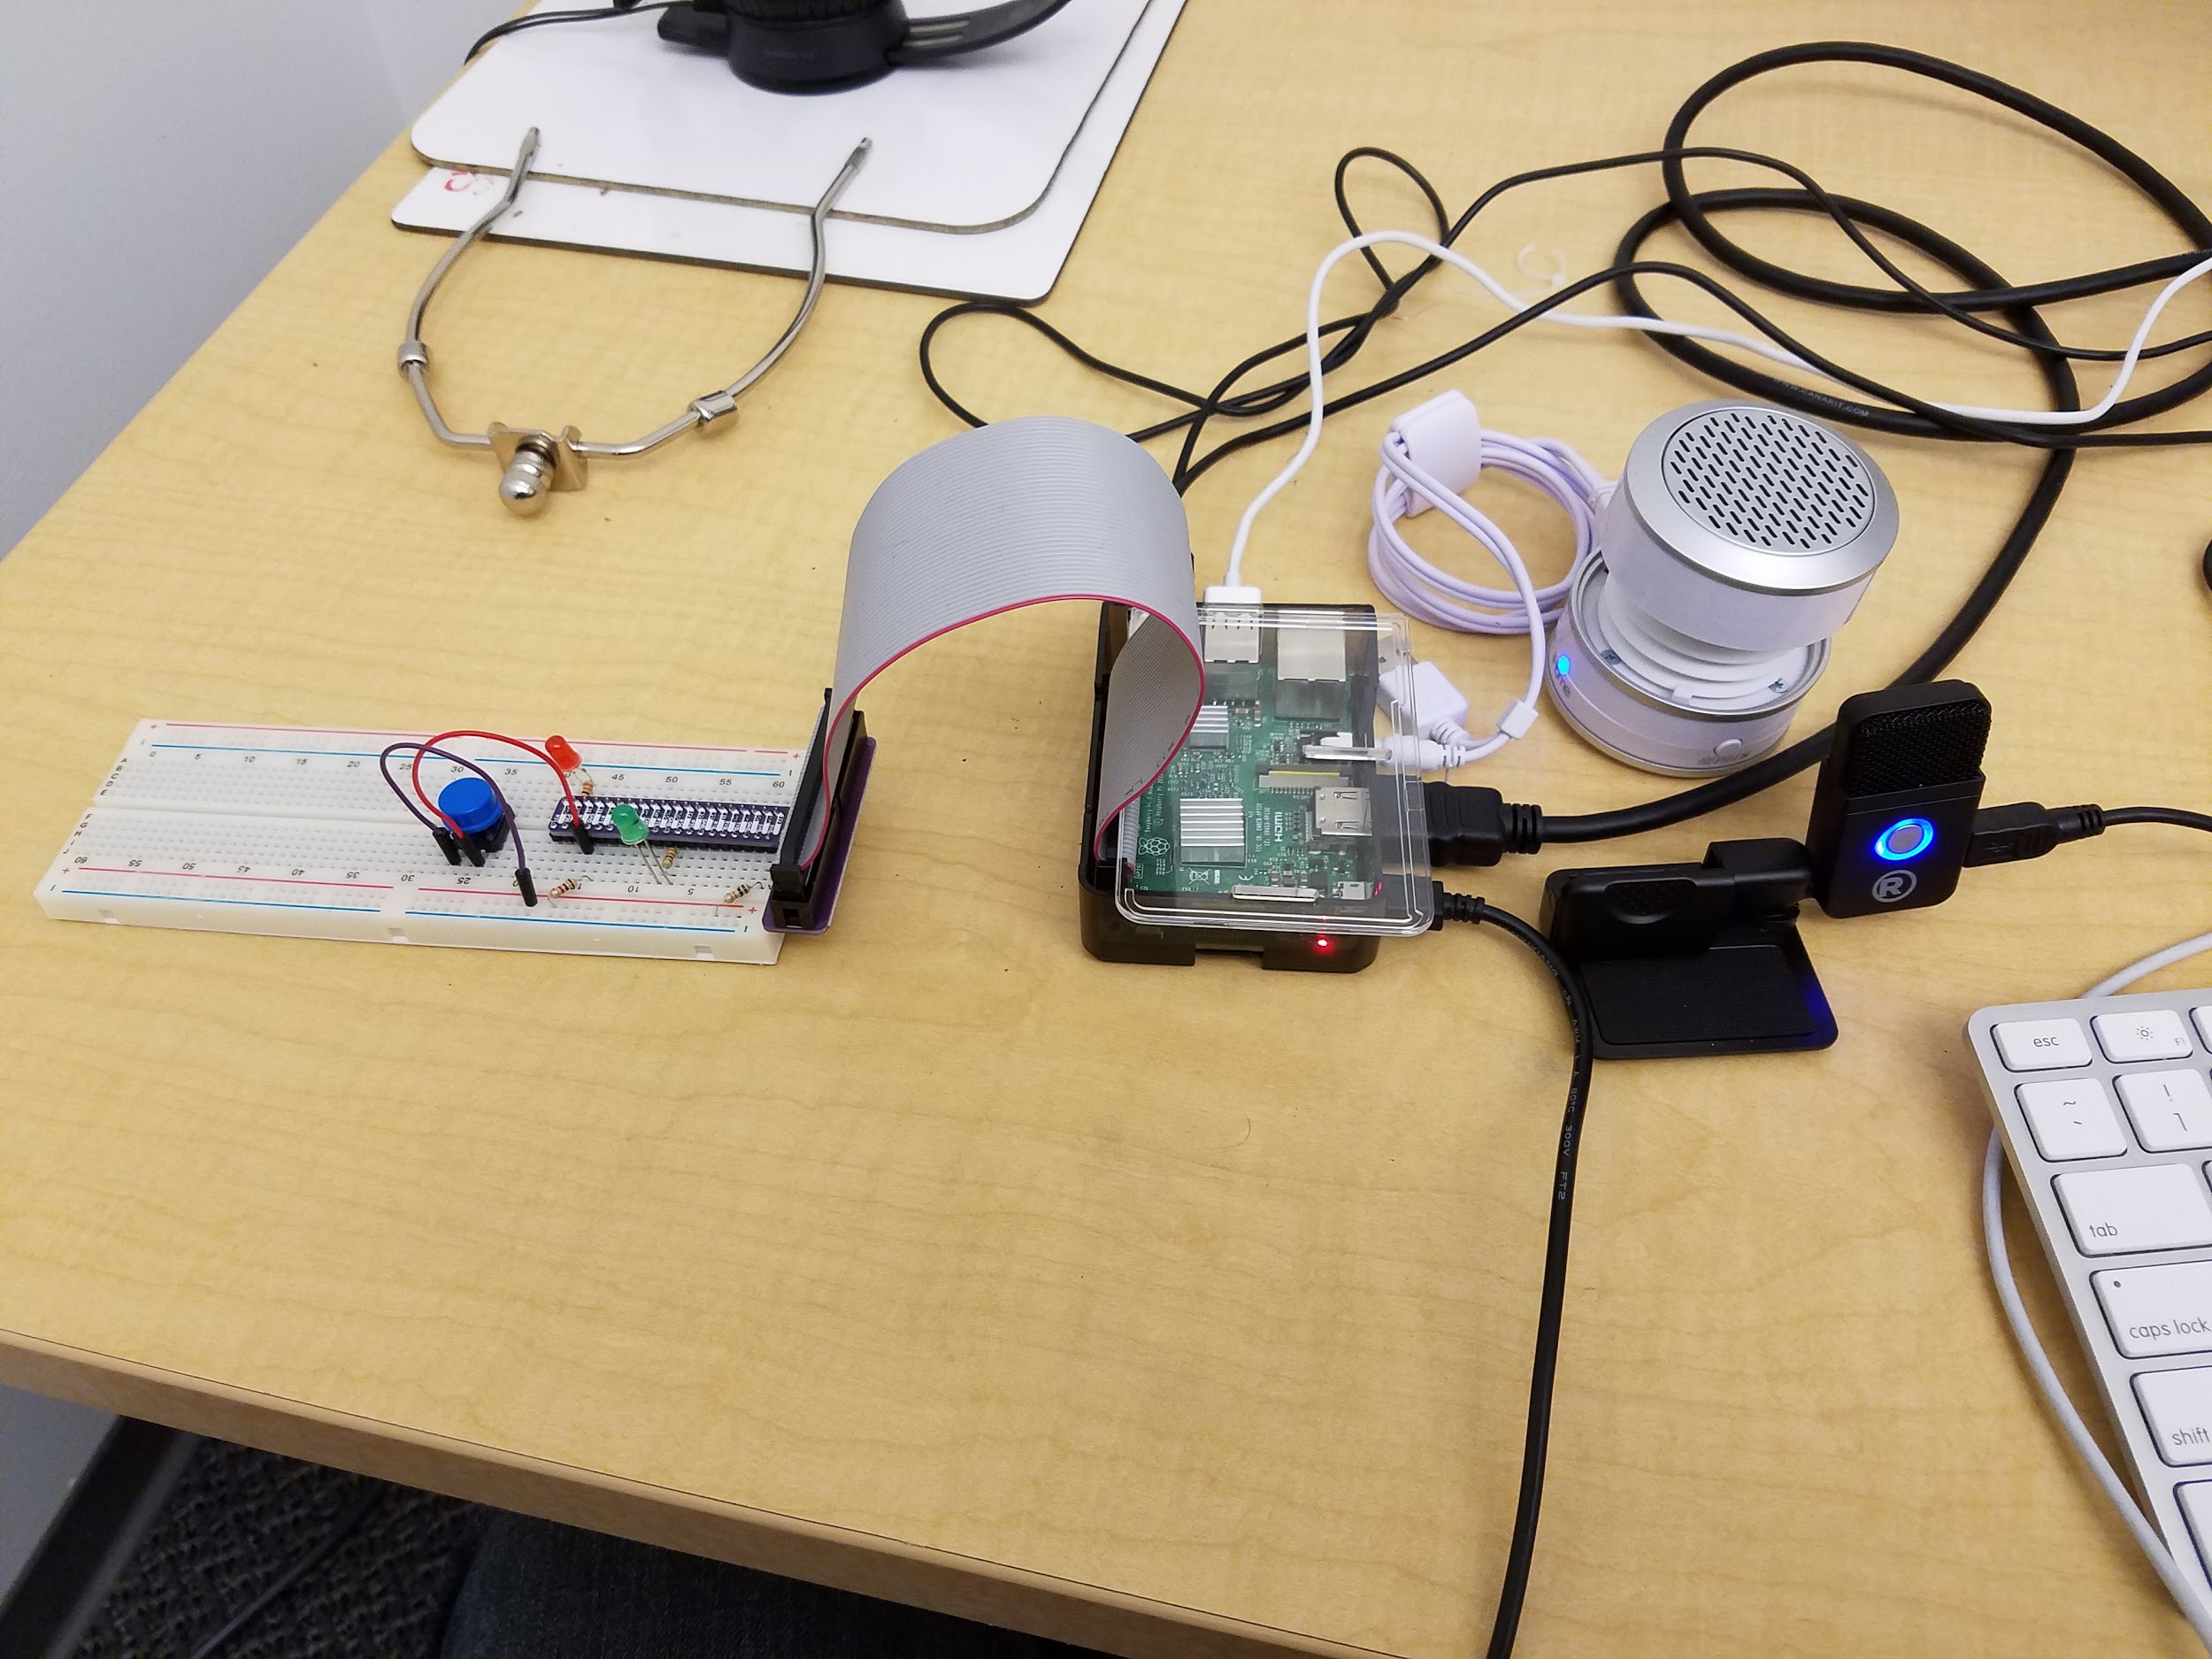
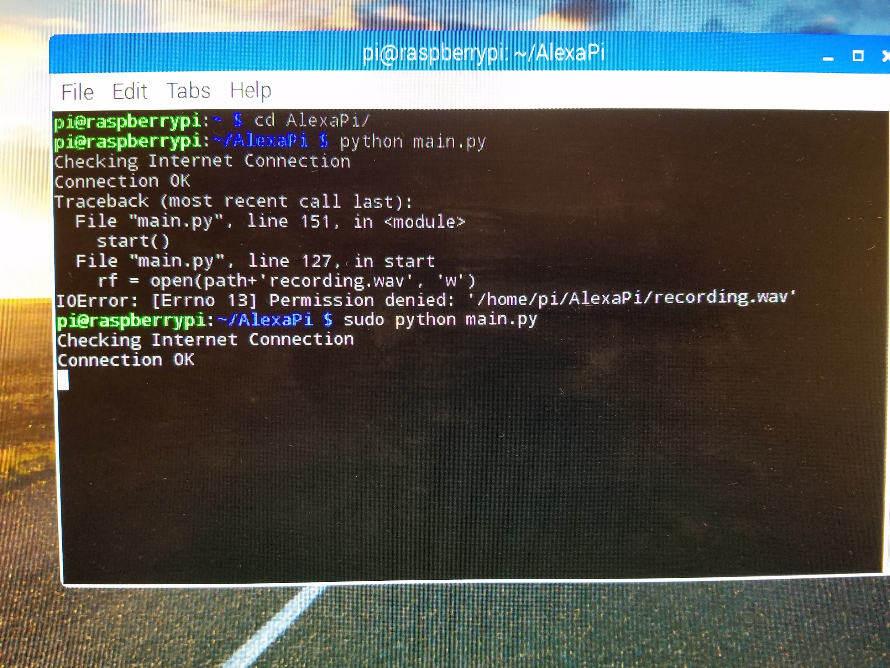
AlexaPi
TEAM LUMOS

Slide 16
LIFX HTTP API Endpoints
TEAM LUMOS
GET Requests
PUT Requests
POST Requests
List Lights
List Scenes
Validate Color
Set State
Set States
Activate Scene
Toggle Power
Breathe Effect
Pulse Effect
Cycle
All LIFX Endpoints receive and send JSON!

Slide 17

Challenges
TEAM LUMOS
Servers
Limitations of using both Flask and Flask-Ask for a flask server deployment on Nginx
Celery
Hardware
Combined limitations of all the software that we used
Notes:
https://pixabay.com/en/new-york-city-tribute-in-lights-sky-78181/

Slide 18
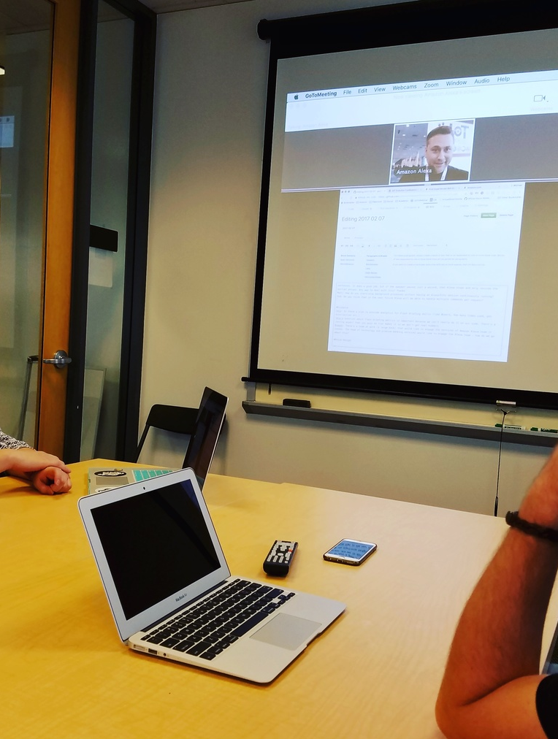
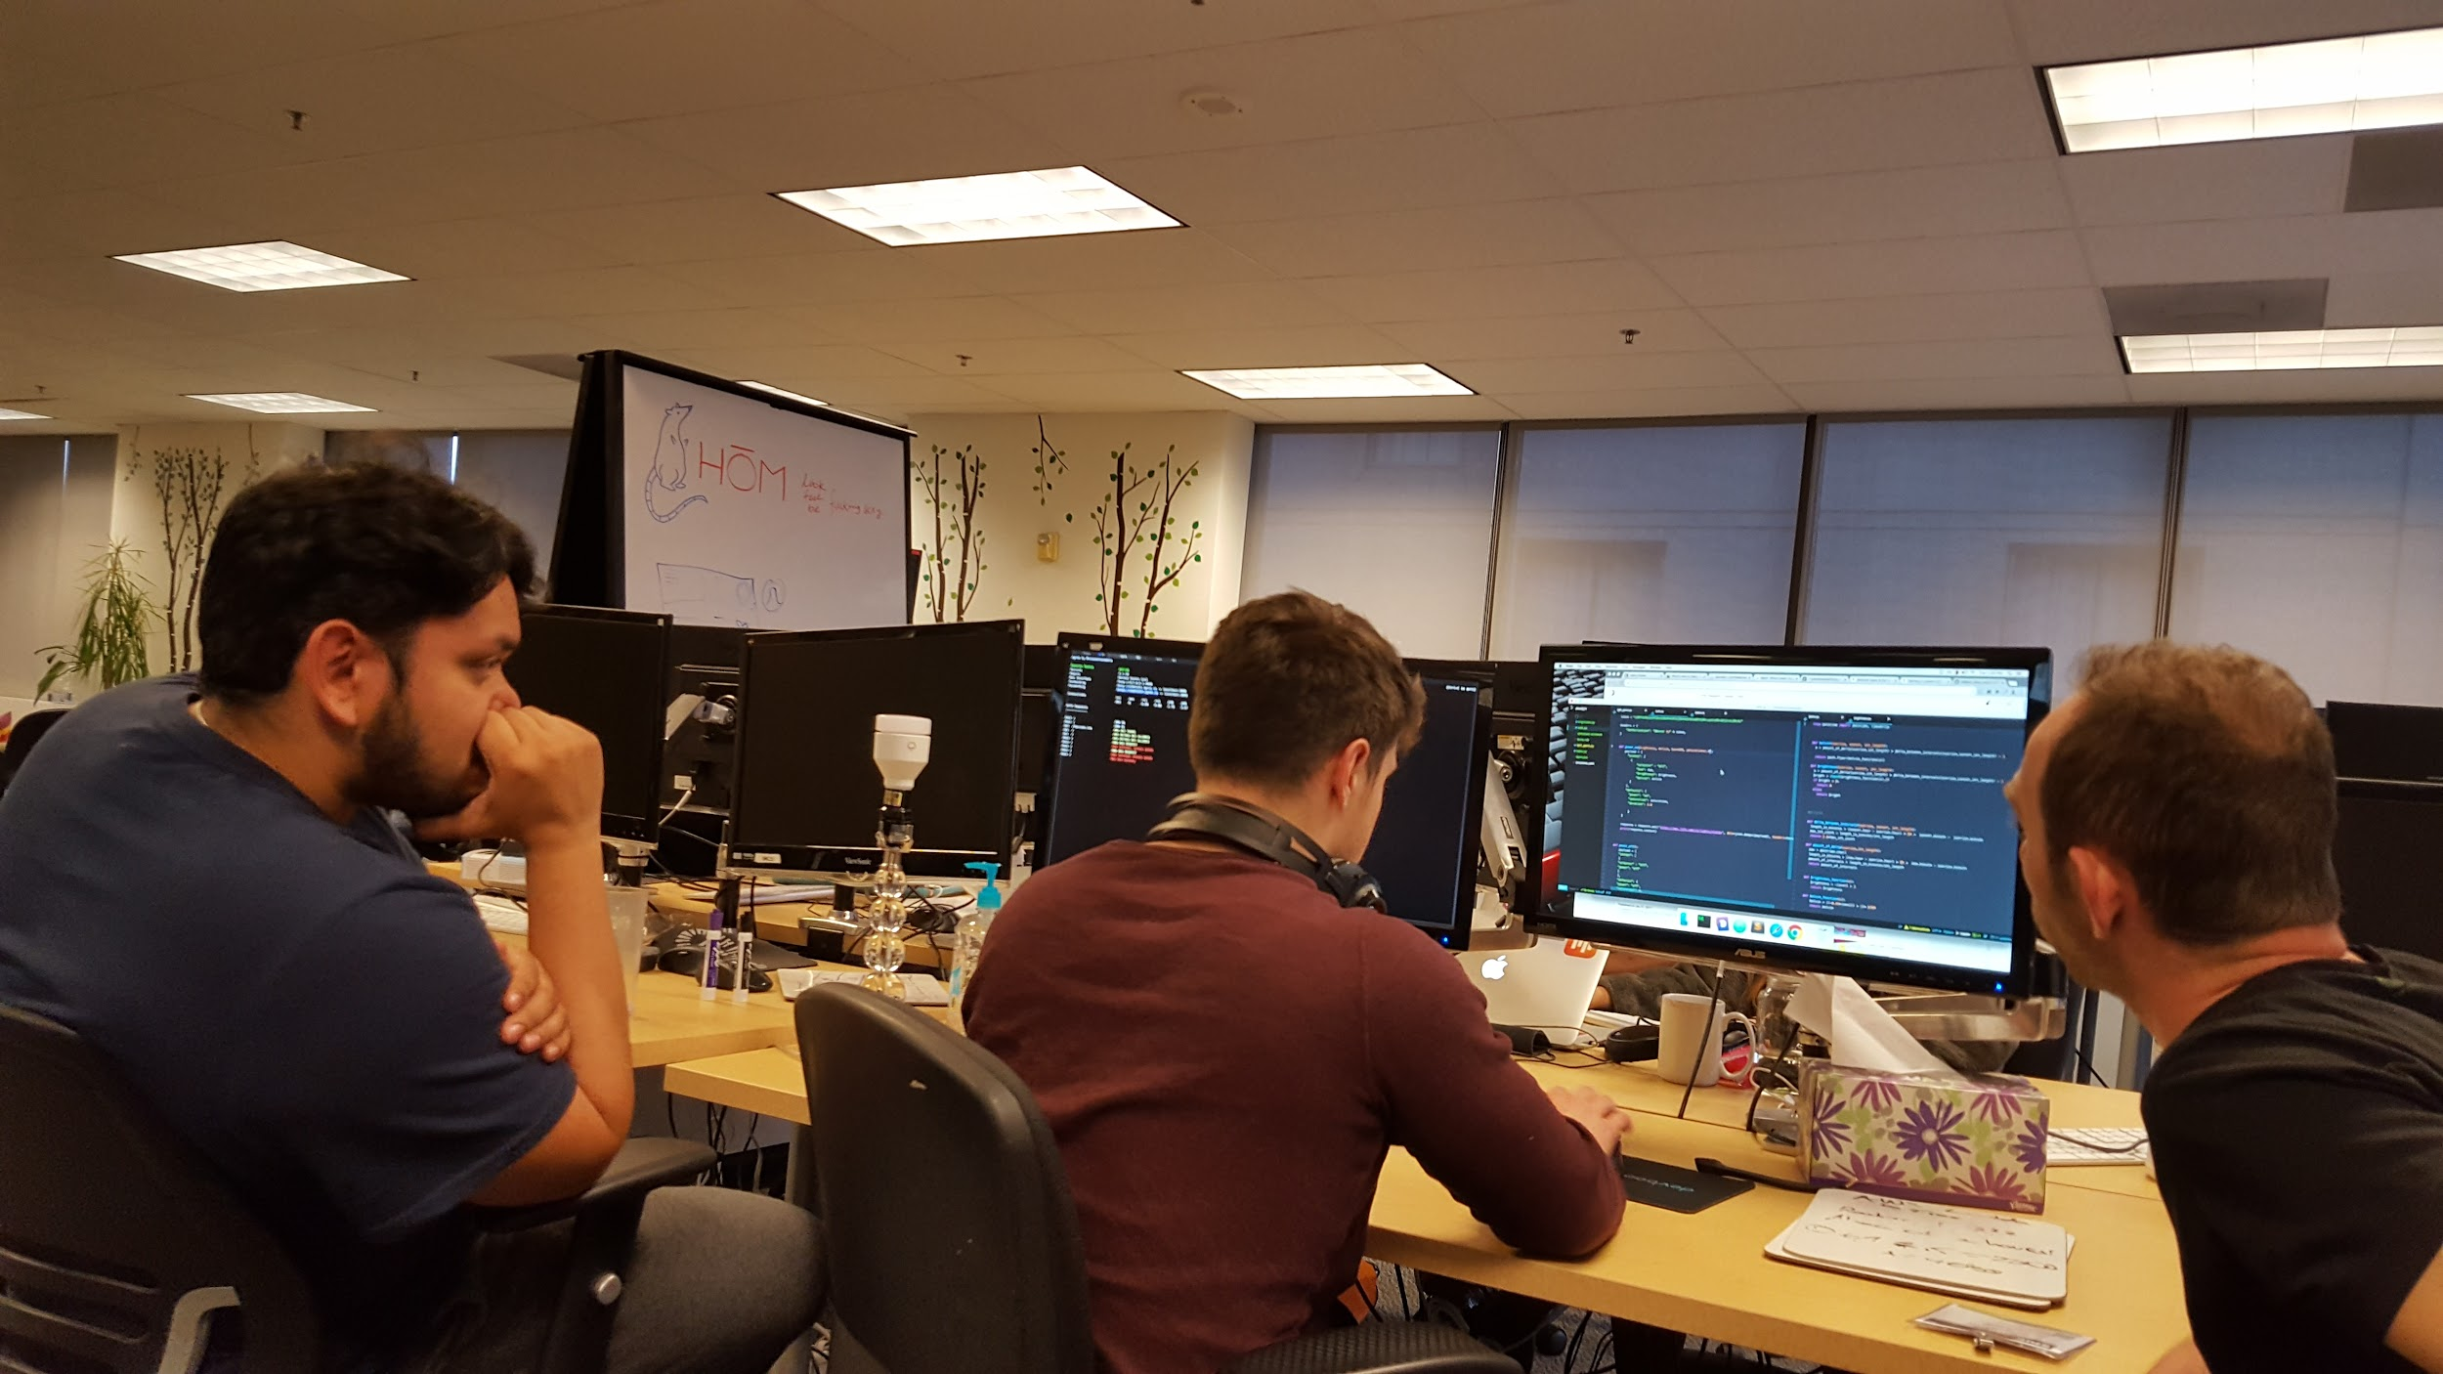
Challenges are Fun Though
Amazon Alexa Hours
50%
32%
70%

Slide 19
Future Steps
TEAM LUMOS
Integrate with AWS
Hands-Free AlexaPi
Expand Services
So that remote servers can run background processes, like Celery, to keep Alexa options available online.
Migrate from a Flask backend to Django for extended support with Celery.
Move to keep Alexa available and fully functional.
Change Alexa to respond to voice commands without the need to push a button.
Future services could be extended to incorporate other smart devices with AlexaPi.
Cater to other consumer services and needs (e.g. treat jet lag, a “Security Mode” with a webcam, scheduled lights for when you’re away on vacation, etc.)

